Slide 1
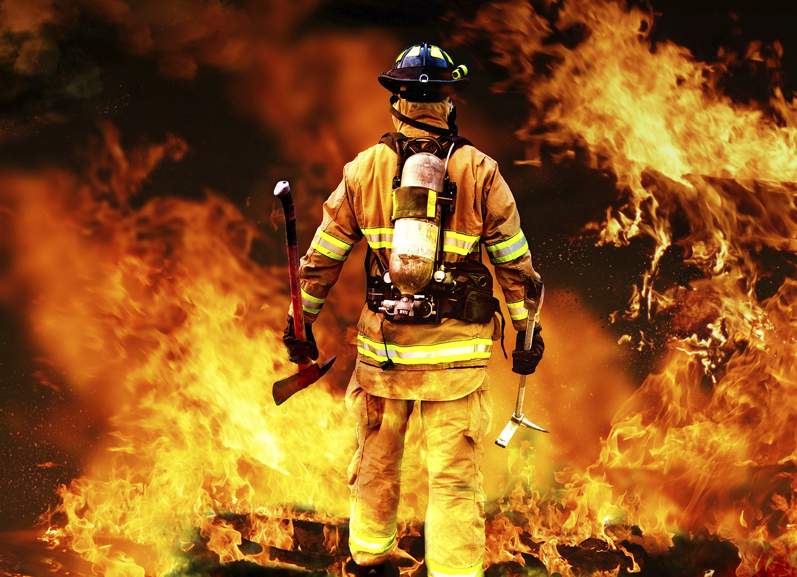
Project based Learning – Internet of Things
SMART FIRE FIGHTING
SNO | NAME | USN
1 | SPARSH GUPTA | 1MS12CS110
2 | VIKAS KUMAR | 1MS12CS130
3 | SANDEEP KUMAR | 1MS12CS097
4 | TUSHAR | 1MS12CS122

Slide 2

INDEX
Project Goals
Description about Sensors (IOT)
Description about the SRS
Description about the Design Architecture with Class Diagram and Sequence Diagram
Implementation details
Results
Conclusion and Future work
Bibliography

Slide 3
PROJECT GOALS
The goal for Smart Fire Fighting is to remove unwanted fire and other harmful events as a limitation to life safety, technical innovation, and economic prosperity.
The vision to improve fire protection and fire fighting is undertaken with the following motivations:
To save lives and minimize injuries to building occupants and community members due to fire.
To improve fire fighter occupational health and safety.
To enhance the operational efficiency of the fire service and the effectiveness of fire protection.
To minimize property loss from fire.
To minimize business interruption and loss of mission continuity due to fire.

Slide 4

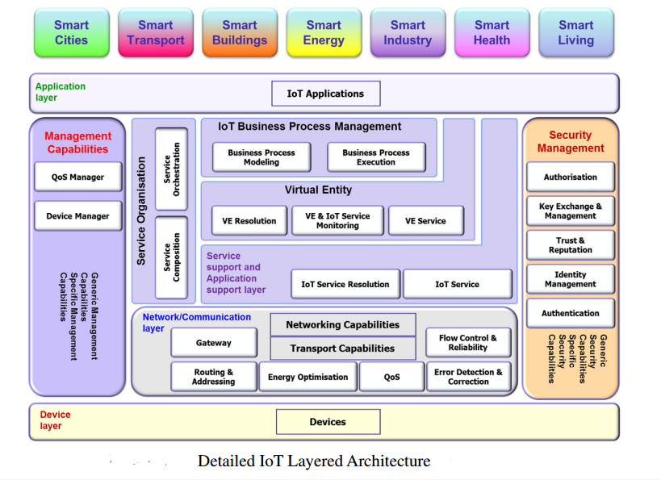
Internet of Things Architecture

Slide 5
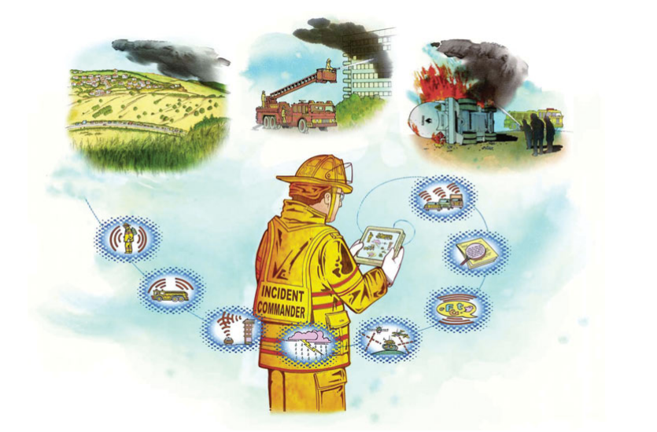
The Evolution from Fire Fighting to Smart Fire Fighting

Slide 6
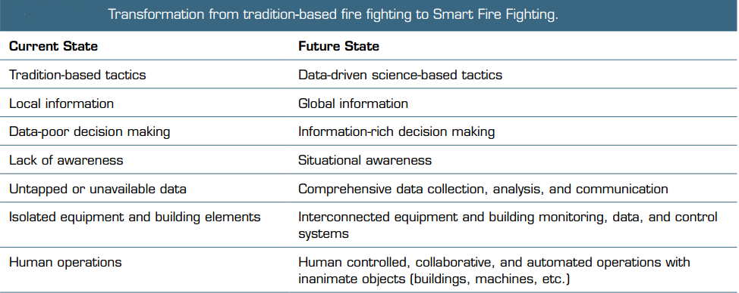
The Evolution from Fire Fighting to Smart Fire Fighting

Slide 7
Problem Definition
Enhancing the fire rescue team efficiency in controlling and rescuing people in fire. This project senses the temperature and smoke in a room and sends the data to the cloud. In case of fire an emergency message is sent to the cloud which can be analyzed by the nearest fire rescue team and the proper action will be taken.
Fire losses throughout the world remain too high and fire fighting too hazardous. Today, data from a variety of sources are collected independently and processed separately, but evolving new technologies are enabling the use of vast amounts of information. The use of this information continues to demonstrate great promise at enhancing the effectiveness and efficiency with the duties handled by fire fighters. Importantly this equates to improved safety and health for this high risk profession, via situational and incident awareness and other factors. Knowledge is power, and harvesting the data important to fire fighters is empowering the smart fire fighter of the future.

Slide 8
DESCRIPTION ABOUT SENSORS
The complex process of information gathering begins with sensors, which are becoming cheaper and more powerful.
Sensors convert the characteristics of the physical environment involved in a fire emergency into raw data, thereby initiating the process of transforming what is perceived into actionable information.
Today, the most common — and in some ways, most important —electronic sensor technologies associated with fire safety in residential buildings are smoke detectors.
The combination of these sensory inputs allows both individual personnel and ICs to assess environmental conditions in real time and to take effective actions to minimize the associated risks. The ability to provide integrated sensors is interdependent on other features such as data logging and communication systems. Further, in order to integrate sensors, standards must be developed to support the necessary hardware and software interoperability.
These sensors will generate a wealth of new data. The availability of the data and the ability to analyze the data open new possibilities for the fire service.

Slide 9
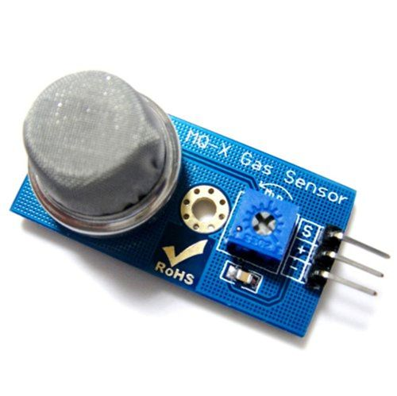
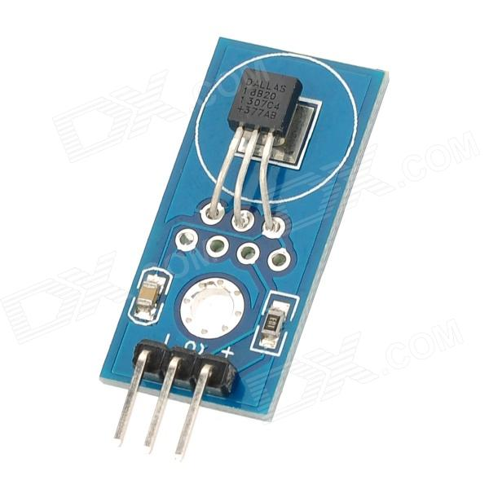
LIST OF SENSORS
There are two sensors which are used in the project.
Smoke Sensor – MQ2
Temperature Sensor – DS18B20

Slide 10
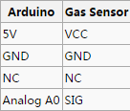
SMOKE SENSOR – MQ2
Hardware Overview –
This is a Analog output sensor. This needs to be connected to any one Analog socket in Base Shield. The examples used in this tutorial makes uses of A0 analog pin. Connect this module to the A0 port of Base Shield.
It is possible to connect the Grove module to Arduino directly by using jumper wires by using the connection as shown in the table:
The output voltage from the sensor increases when the concentration of gas increases. Sensitivity can be adjusted by varying the potentiometer.

Slide 11
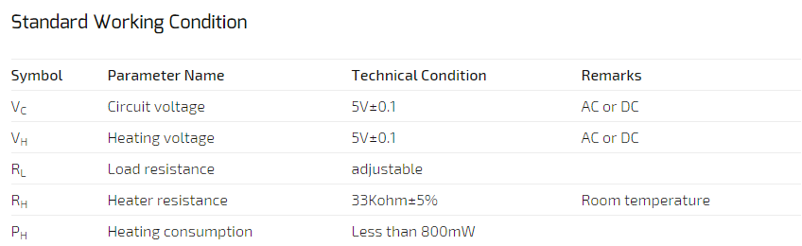
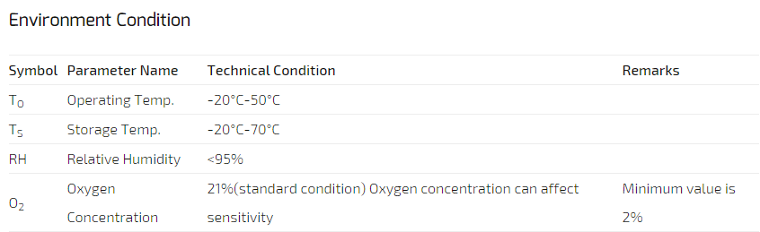
SMOKE SENSOR – MQ2

Slide 12
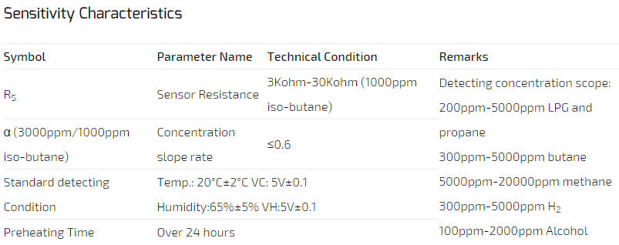
SMOKE SENSOR – MQ2

Slide 13
SMOKE SENSOR – MQ2
Features :
Wide detecting scope
Fast response and High sensitivity
Stable and long life
Simple drive circuit
Applications :
They are used in gas leakage detecting equipments in family and industry, are suitable for detecting of LPG, i-butane, propane, methane ,alcohol, Hydrogen, smoke.

Slide 14
TEMPERATURE SENSOR – DS18B20
Hardware Overview –
The DS18B20 digital thermometer provides 9-bit to 12-bit Celsius temperature measurements and has an alarm function with non volatile user programmable upper and lower trigger points.
The DS18B20 communicates over a 1-Wire bus that by definition requires only one data line (and ground) for communication with a central microprocessor.
It has an operating temperature range of -55°C to +125°C and is accurate to ±0.5°C over the range of -10°C to +85°C.
In addition, the DS18B20 can derive power directly from the data line (“parasite power”), eliminating the need for an external power supply.

Slide 15
TEMPERATURE SENSOR – DS18B20
Features :
Unique 1-Wire® Interface Requires Only One Port Pin for Communication
Each Device has a Unique 64-Bit Serial Code Stored in an On-Board ROM
Multi drop Capability Simplifies Distributed Temperature-Sensing Applications
Requires No External Components
Can Be Powered from Data Line; Power Supply Range is 3.0V to 5.5V
Measures Temperatures from -55°C to +125°C (-67°F to +257°F)
±0.5°C Accuracy from -10°C to +85°C
Thermometer Resolution is User Selectable from 9 to 12 Bits
Converts Temperature to 12-Bit Digital Word in 750ms (Max)

Slide 16
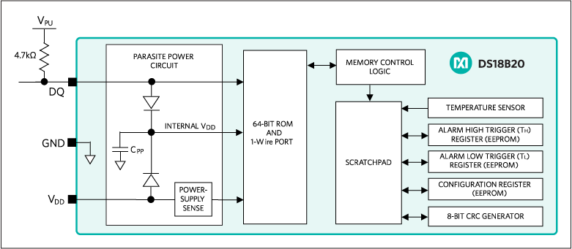
TEMPERATURE SENSOR – DS18B20
BLOCK DIAGRAM

Slide 17
TEMPERATURE SENSOR – DS18B20
Applications :
Applications Include Thermostatic Controls, Industrial Systems, Consumer Products, Thermometers, or Any Thermally Sensitive System.
Agricultural Equipment
Audio Equipment
Climate Control
GPS Devices
Hard Disk Drive
Medical Equipment
Set-Top Boxes
Telecommunications

Slide 18
DESCRIPTION ABOUT SRS
A software requirements specification (SRS) is a description of a software system to be developed, laying out functional and non-functional requirements, and may include a set of use cases that describe interactions the users will have with the software.
Software requirements specification establishes the basis for an agreement between customers and contractors or suppliers (in market-driven projects, these roles may be played by the marketing and development divisions) on what the software product is to do as well as what it is not expected to do.
It should also provide a realistic basis for estimating product costs, risks, and schedules.

Slide 19
DESCRIPTION ABOUT SRS
The organization of SRS is as follows:
1. Introduction
Purpose and Scope of Product - The scope of the project is to prepare a SMART system that will enhance the fire rescue team efficiency in controlling and rescuing people in fire.
Intended Audience - This document is intended for all individuals participating in and/or supervising the SFFS project.
Definitions, Acronyms, and Abbreviations
References
2. Overall Description
Product Perspective - While the mobile application or web application is the main focus of the project, there is also a server-side component which will be responsible for database and synchronization services using open source Cloud services such as Ubidots.
Product Features – The core features and additional features are included.
User Characteristics - The web site and cloud server needs to be accessible by an experienced and authorized individual.
Operating Environment - The system being developed will be running under Raspbian embedded operating system.
General Constraints
Assumptions and Dependencies

Slide 20
DESCRIPTION ABOUT SRS
The organization of SRS is as follows:
3. SPECIFIC Requirements
External Interface requirements
User Interfaces - The user interface for the system will be a web page and a cloud service on the Internet.
Hardware Interfaces - Hardware requirements
Software Interfaces - The software interface includes Raspberry Pi 2 platform.
Communication Interfaces – It includes web interface and cloud server interface.
Functional requirements - The system has been divided into four modules -
Data owner module
Server module
Receiver module
Data Storage module

Slide 21
DESCRIPTION ABOUT SRS
The organization of SRS is as follows:
3. SPECIFIC Requirements
Software system attributes
Reliability - The system is available all time and mainly the reliability of the system depends on the sensors and the board.
Availability - The system must be available for use and there has to be continuous monitoring of data.
Security - Security measures are written.
Portability - The system should be portable and must run on different platforms.
Maintenance - System is easily maintainable as it has fewer components and its design is not complicated. The system also provides capability to back-up the data.
Performance - Performance requirements of system are mentioned.

Slide 22
DESCRIPTION ABOUT SRS
The organization of SRS is as follows:
4. Performance Requirements –
The performance of the system is determined by processor speed and the internet connection and hence performance varies based on these factors.
Modem Connection
Broadband Connection
Number of users
The performance is also measured in terms of the output provided by application.
5. Database Requirements
Database -
The database here is Ubidots cloud server.
Operating System
The Development environment shall be Windows 7 and above.
Web-Based
The system shall be a Web-based application.

Slide 23
DESCRIPTION ABOUT SRS
The organization of SRS is as follows:
6. Design constraints
Synchronization:
Uses USB 3.0.
Connects only to Windows 7 and above.Memory
Memory:
Device will have a SD card slot, and the software must be able to read and write to that slot.
GUI is available only in English.
Login and password is used for the identification of users.
Limited to HTTP/HTTPS.
This system is working for single server.
7. Other Requirements
The fire fighting department officials as well as the users must agree with all the terms and conditions provided by the system administrator and local authority. They should obey all International Standards and Protocols.

Slide 24
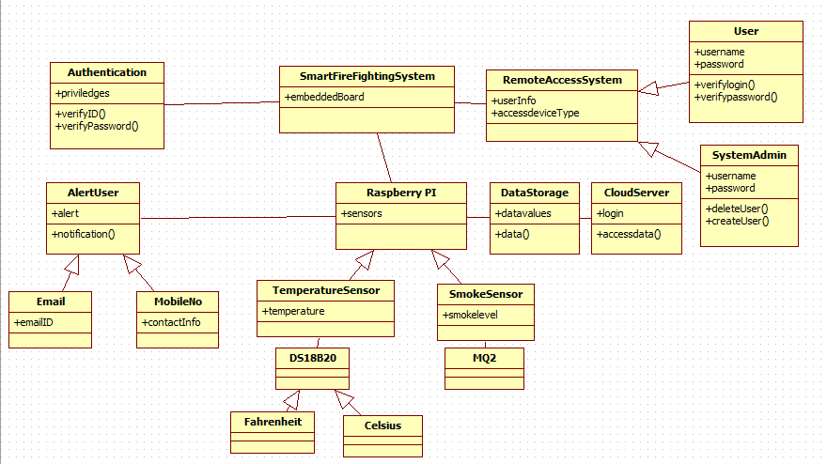
DESCRIPTION ABOUT DESIGN
Class Diagram -

Slide 25
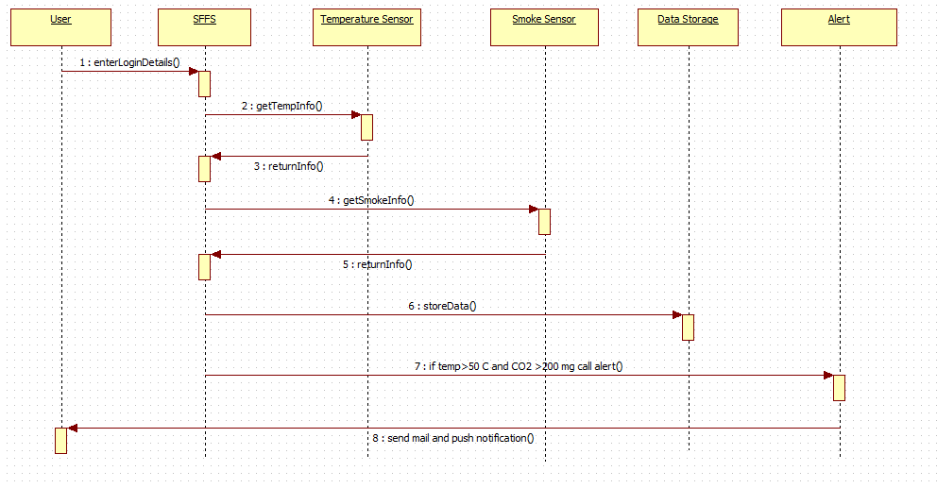
DESCRIPTION ABOUT DESIGN
Sequence Diagram -

Slide 26
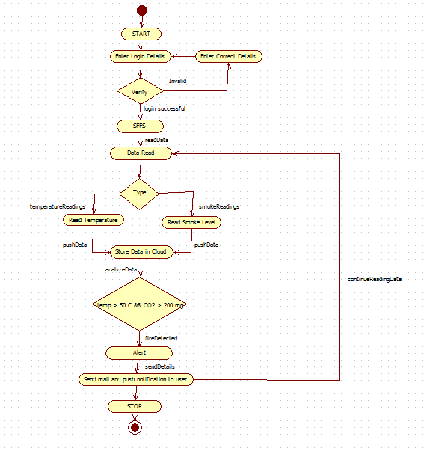
DESCRIPTION ABOUT DESIGN
Activity Diagram -

Slide 27
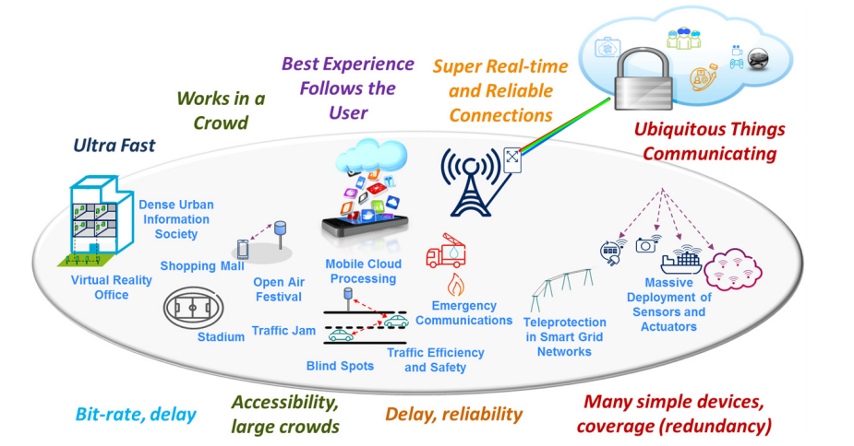
Cloud in IOT

Slide 28
IMPLEMENTATION DETAILS
Tools Introduction
PUTTY
PuTTY is a free and open-source terminal emulator, serial console and network file transfer application. It supports several network protocols, including SCP, SSH, Telnet, rlogin, and raw socket connection. It can also connect to a serial port(since version 0.59). The name "PuTTY" has no definitive meaning.
PuTTY was originally written for Microsoft Windows, but it has been ported to various other operating systems. Official ports are available for some Unix-like platforms, with work-in-progress ports to Classic Mac OS and Mac OS X, and unofficial ports have been contributed to platforms such as Symbian, Windows Mobile and Windows Phone.

Slide 29
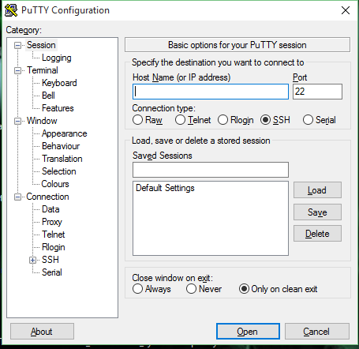
IMPLEMENTATION DETAILS
PUTTY Features :
PuTTY supports many variations on the secure remote terminal, and provides user control over the SSH encryption key and protocol version, alternate cipher like 3DES, Arcfour, Blowfish, DES, and Public-key authentication. It can also be used with local serial port connections.
PuTTY comes bundled with command-line SCP and SFTP clients, called "pscp" and "psftp" respectively.

Slide 30
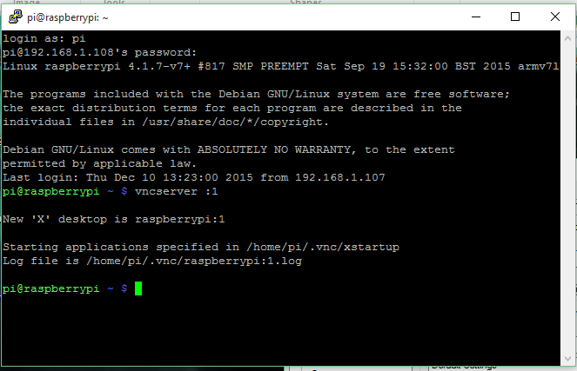
IMPLEMENTATION DETAILS
PUTTY Terminal Server:

Slide 31
IMPLEMENTATION DETAILS
VNC Server -
TightVNC is a cross-platform free and open-source remote desktop software application that uses and extends the RFB protocol of Virtual Network Computing (VNC) to control another computer's screen remotely. It was created by Constantin Kaplinsky.
Compatibility -
TightVNC is cross-compatible with other client and server implementations of VNC; however, tight encoding is not supported by most other implementations, so it is necessary to use TightVNC at both ends to gain the full advantage of its enhancements.^{[5]}
Among notable enhancements are file transfers, support for Windows DFMirage mirror driver to detect screen updates (saves CPU time and increases the performance of TightVNC), ability to zoom the picture and automatic SSH tunneling on Unix.

Slide 32
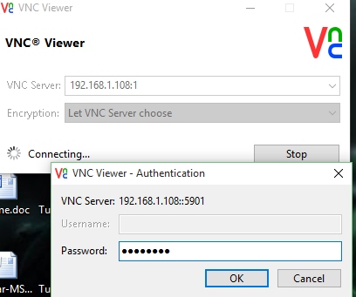
IMPLEMENTATION DETAILS
VNC Server -

Slide 33
IMPLEMENTATION DETAILS
Technology Introduction
The following technologies has been used in the project
Python
Ubidots Cloud Service

Slide 34
IMPLEMENTATION DETAILS
Python
Python is a widely used general-purpose, high-level programming language. Its design philosophy emphasizes code readability, and its syntax allows programmers to express concepts in fewer lines of code than would be possible in languages such as C++ or Java. The language provides constructs intended to enable clear programs on both a small and large scale.
Python supports multiple programming paradigms, including object oriented, imperative and functional programming or procedural styles. It features a dynamic type system and automatic memory management and has a large and comprehensive standard library.
Python code is used in this project to read the sensors data through raspberry pi 2 board.
Python code is also used to send data to the cloud.

Slide 35
IMPLEMENTATION DETAILS
Ubidots Cloud Service
Cloud Service is used in this system. Ubidots is a free Internet of Things website which provides a free storage of data on cloud and allows to analyze those data. Analyzed data is stored and if some limit is crossed in data which are set by us, an event is generated which sends an e-mail to the respective person.
Ubidots helps you create applications that capture real-world data and turn it into meaningful actions and insights.

Slide 36
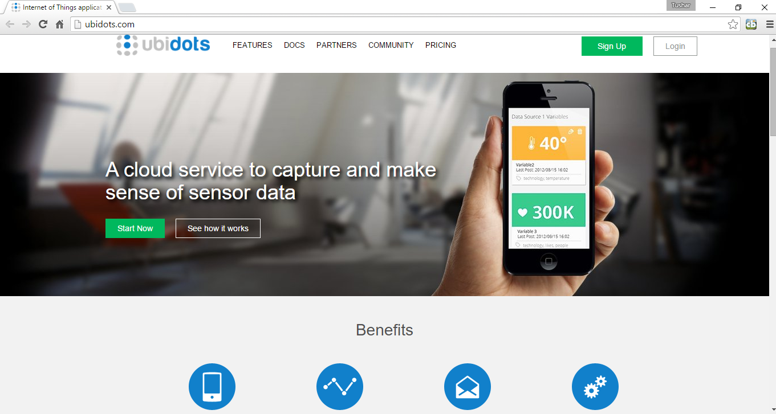
IMPLEMENTATION DETAILS
Ubidots Cloud Service

Slide 37
IMPLEMENTATION DETAILS
ALGORITHM -
readSensorData(); // reads the data from smoke and temperature sensor
if somkeFound() or temperature > someFixedValue
onBuzzer();
triggerEvent(); // send the mail to the respective user
uploadDataOnCloud();
displaySensorData();

Slide 38
IMPLEMENTATION DETAILS
Number of modules
The modules used in the project are -
Client Module - Raspberry Pi and sensors
Server Module - Ubidots cloud server

Slide 39
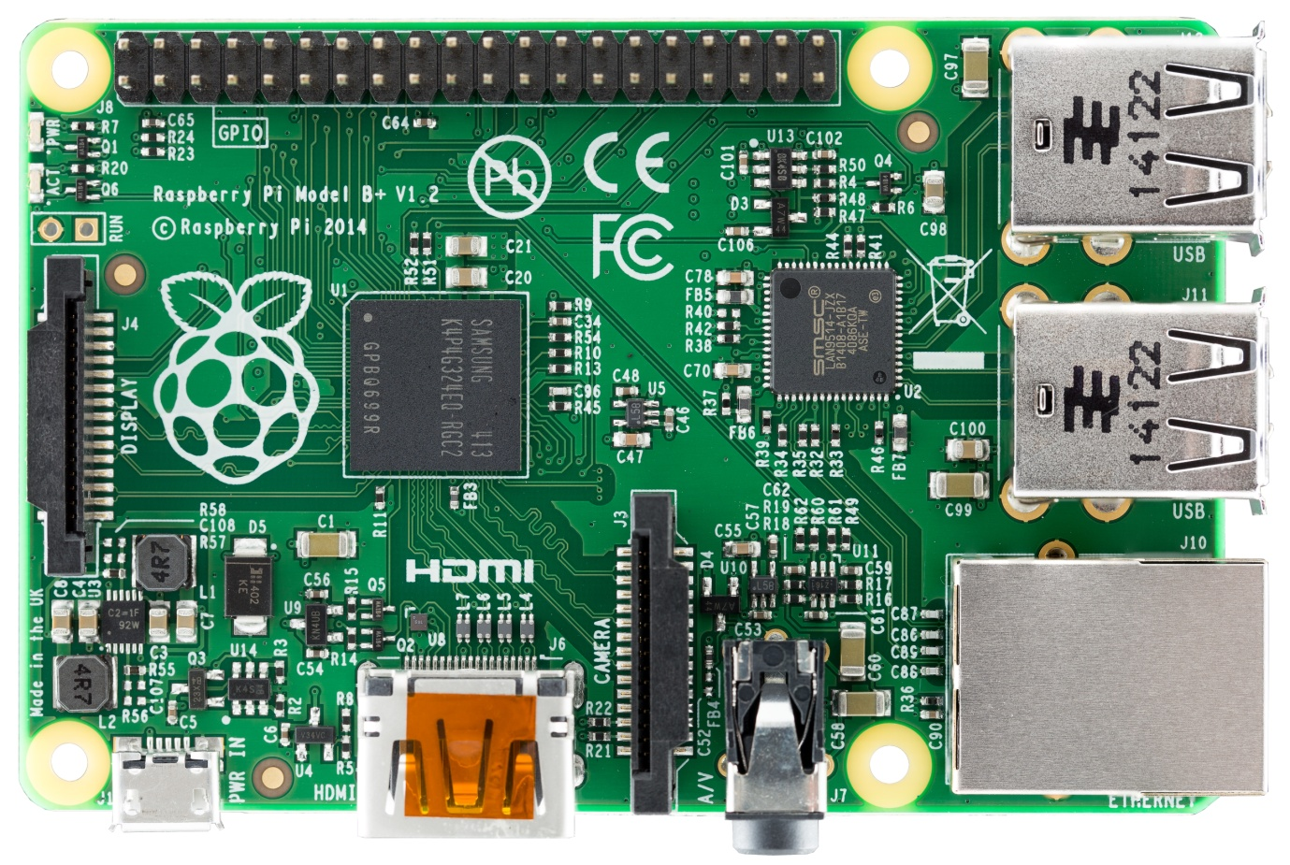
IMPLEMENTATION DETAILS
Client Module - Raspberry Pi
The Raspberry Pi is a low cost, credit-card sized computer that plugs into a computer monitor or TV, and uses a standard keyboard and mouse. It is a capable little device that enables people of all ages to explore computing, and to learn how to program in languages like Scratch and Python.

Slide 40
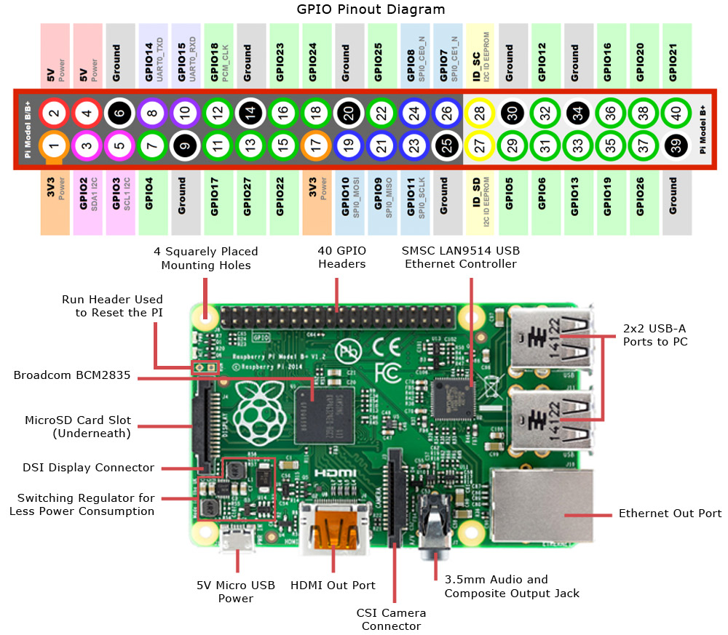
IMPLEMENTATION DETAILS

Slide 41
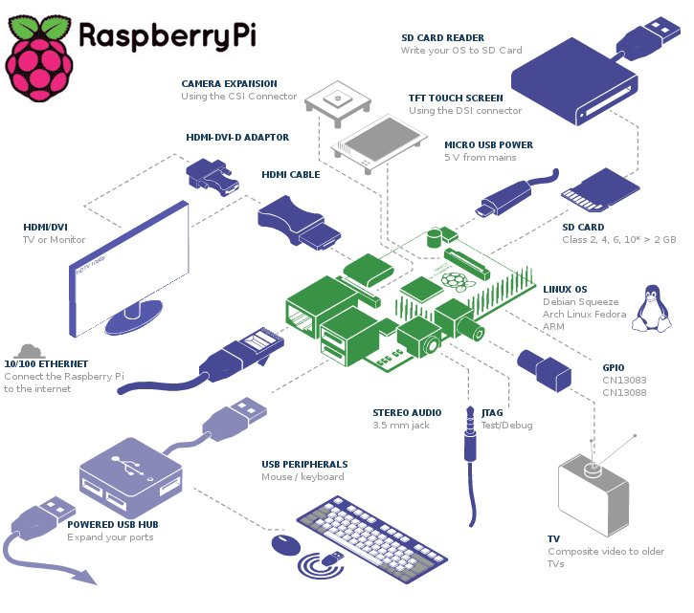
IMPLEMENTATION DETAILS

Slide 42
SECURITY PROTOCOL FOR SMART FIRE FIGHTING
The Internet of Things (IoT) is growing by leaps and bounds every day. But as the IoT grows, so do the security vulnerabilities of the linked objects. A security protocol to protect IoT devices will always be needed.
Building In Security Measures for the Smart Fire Fighting System-
The most obvious one is securing the Web interface of the device. Simple things like making sure that default usernames and passwords are changed during initial setup helps greatly. And the changes shouldn’t allow the use of weak passwords. Perhaps measures such as an account lockout after three to five failed login attempts should be considered.
Attention should be paid to passwords beyond just initial setup changes. Two factor authentication may be needed for sensitive areas like administrator accounts.
Examining the Web interface for resistance to common attacks like cross-site scripting, cross-site request forgery and SQL injection should be done, too. These attacks are harmful if successful, but they’re also relatively simple in nature, which makes them preventable with the right proactive safeguards.
One trick attackers use involves scanning for open ports with a special program and then exploiting those ports. Universal Plug and Play (UPnP) has only exacerbated this problem by standardizing network access points. Open ports can now be used to launch denial-of-service (DoS) attacks as well as buffer overflow attacks across networks and devices.

Slide 43
Technical Challenges
A large number of standards associated with Smart Fire Fighting remain to be resolved, including the following issues :
• Secure standard methods of transmitting a standard set of data in a standardized format.
• Standardized information for first responders and standard building data models.
• Choice of standard communication protocols and user interfaces.
• Establishment of criteria to automatically route 1-0-1 calls based on message content.
• Implementation of appropriate authorization, authentication, and security protocols.
• Standards for accessing and using cloud-based services.
• Plug-and-play architectures that facilitate integration of components.

Slide 44
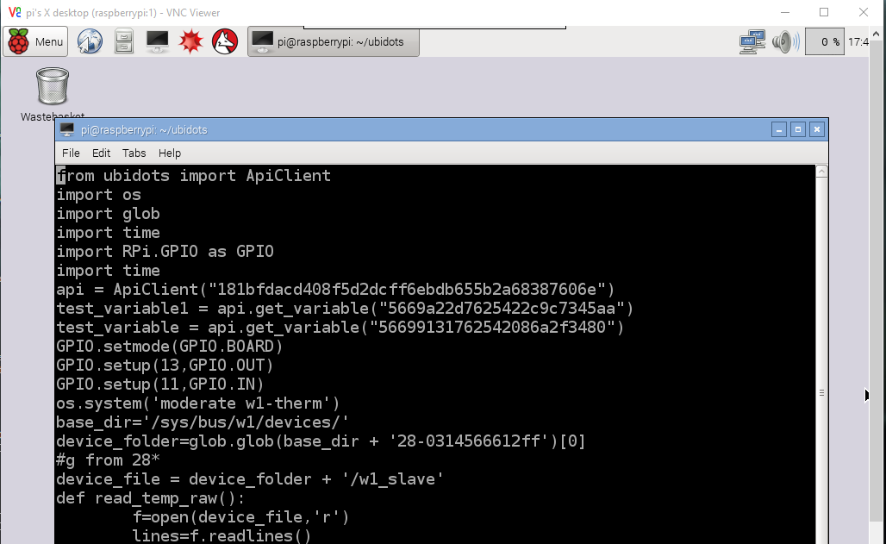
RESULTS
Python Code

Slide 45
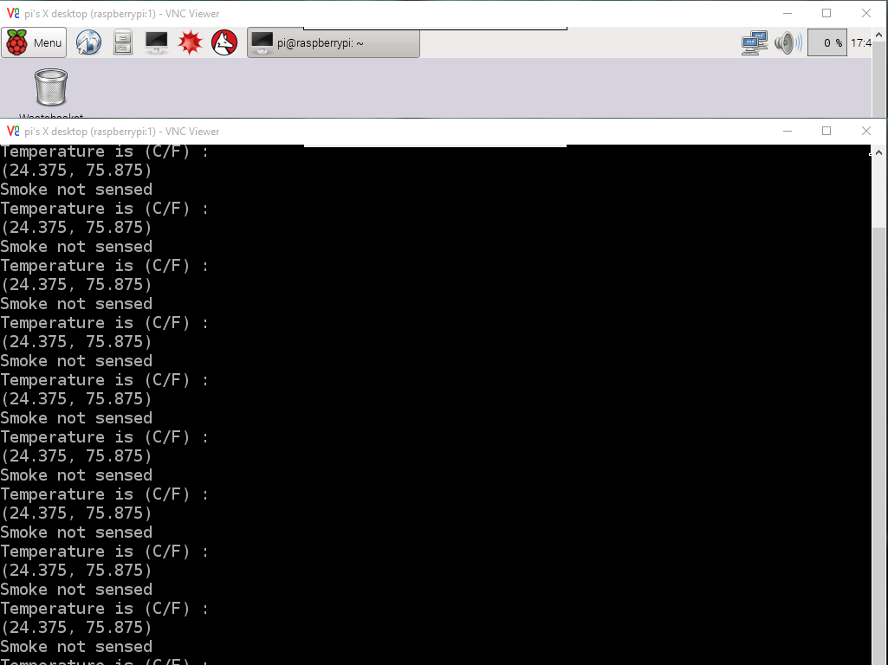
RESULTS
Python Code Sample Output

Slide 46
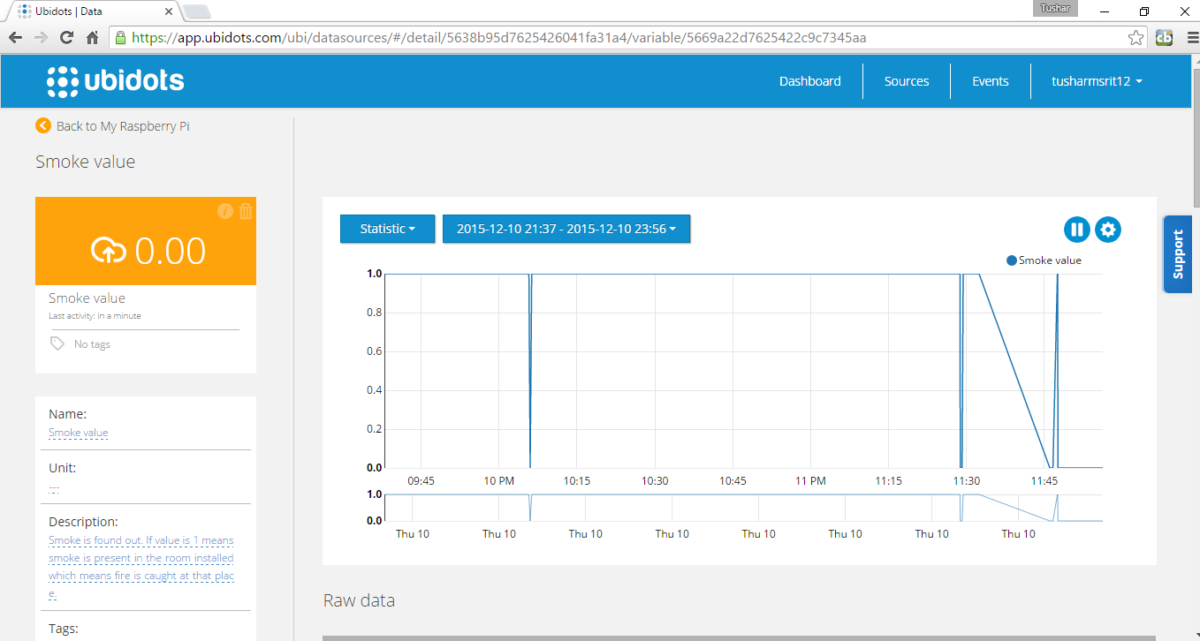
RESULTS
Ubidots Smoke Source
This source contains the value of smoke. If the smoke value, which is a digital value, is 1 means smoke is detected else smoke is not detected.

Slide 47
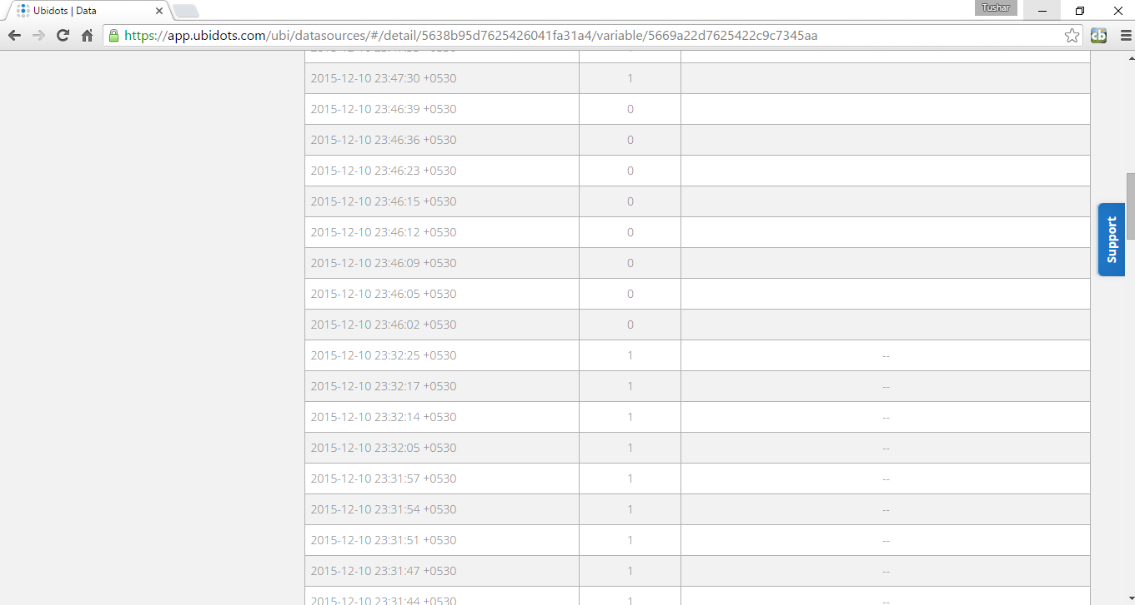
RESULTS
Ubidots Smoke Source Data

Slide 48
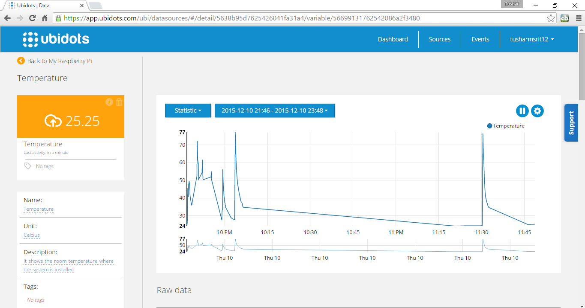
RESULTS
Ubidots Temperature Source
This shows the temperature source. It shows the different temperature sensed by the sensor per second. A graph is also present which shows the previous data of the temperature.

Slide 49
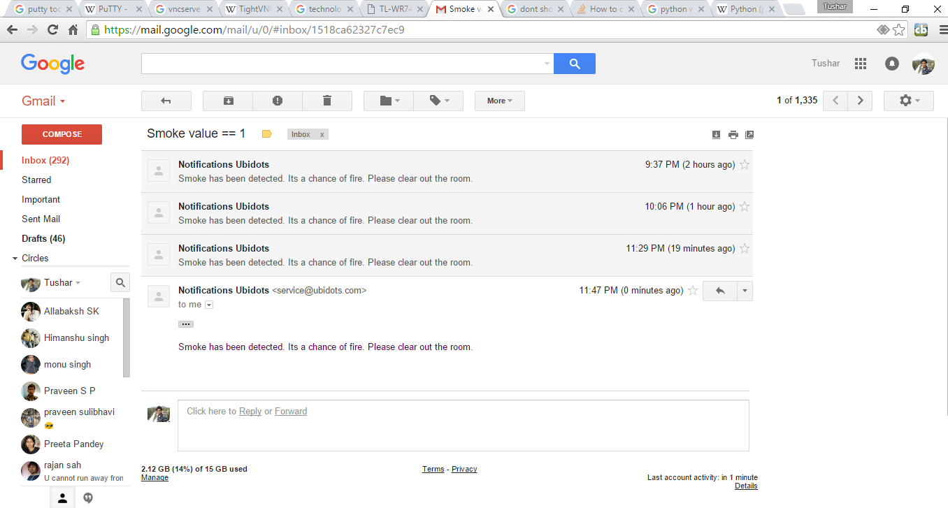
RESULTS
Events :
Events are generated if smoke value is 1 or temperature is above 50. It can be changed accordingly.

Slide 50
Conclusion
The report concludes in outlining four central areas where the best efforts must be put into in order to reach a reality of “smart fire-fighting”:
Increased use of sensors during a fire event to increase awareness to the happenings in the field and the firemen’s location.
Gathering more data and analyzing it in advance to manage more efficiently at the time of the event.
Sharing mutual knowledge between different information systems.
Developing smart systems that help the decision making process.

Slide 51
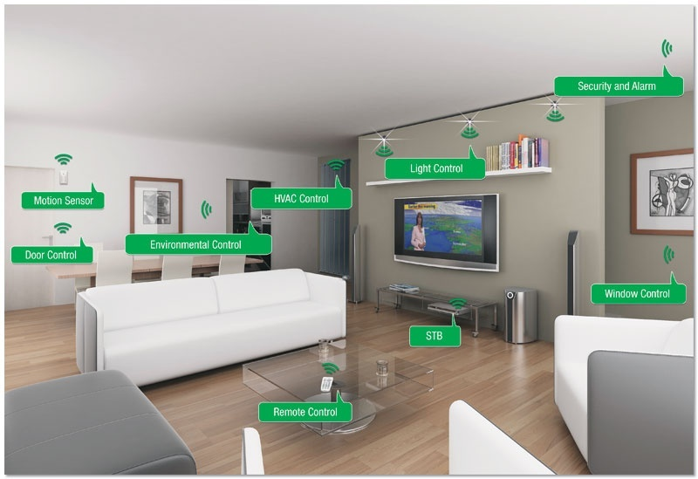
FUTURE WORK
Almost all things will work on your voice in future as described by this image.

Slide 52
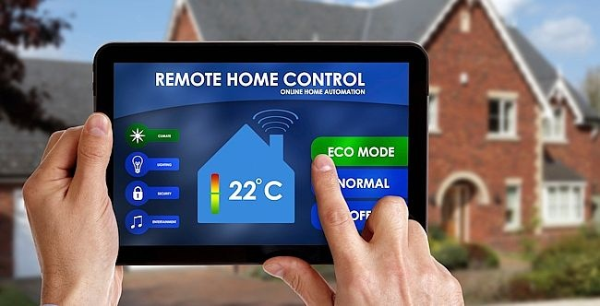
FUTURE WORK
Another example of "Almost Everything is in Control with IoT".

Slide 53
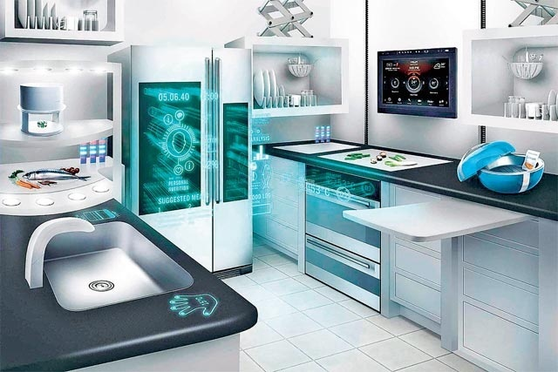
FUTURE WORK
You will control the inside environment of your home from outside.

Slide 54
BIBLIOGRAPHY
[1]https://www.nedcc.org/free-resources/preservation-leaflets/3.-emergency- management/3.2-an-introduction-to-fire-detection,-alarm,-and-automatic-fire-sprinklers
[2] http://ubidots.com/
[3]http://www.govtech.com/fs/New-Era-in-Firefighting-Leverages-the-Internet-of-Things.html
[4]http://www.forbes.com/sites/federicoguerrini/2015/06/29/firefighters-and-the-internet-of-things/
[5]http://www.jbrehm.com/blog/2015/6/11/smart-fire-fighting-merging-iot-and-big-data-for-fire-safety
[6] http://www.criticallink.com/2015/07/firefighting-and-the-iot/
[7] http://www.nist.gov/el/fire_research/201506_smart_fire_roadmap.cfm
[8] IEEE Journals and papers - http://ieeexplore.ieee.org/
[9] http://blog.ubidots.com/topic/raspberry-pi

